Slide 1

Module5
MODULE – V: CONNECT TO AN EXTERNAL API (08) REDUX store using the official create store function, REDUX toolkit has a configure store API, loading state for that particular API, adding an API service as a middleware, example uses create REACT App.

Slide 2
Redux
React redux is an advanced state management library for React. As we learned earlier, React only supports component level state management. In a big and complex application, large number of components are used. React recommends to move the state to the top level component and pass the state to the nested component using properties. It helps to some extent but it becomes complex when the components increases.
React redux chips in and helps to maintain state at the application level. React redux allows any component to access the state at any time. Also, it allows any component to change the state of the application at any time.

Slide 3
Redux
React redux maintains the state of the application in a single place called Redux store. React component can get the latest state from the store as well as change the state at any time. Redux provides a simple process to get and set the current state of the application and involves below concepts.
Store − The central place to store the state of the application.
const store = createStore(Reducer);
Actions − Action is an plain object with the type of the action to be done and the input (called payload) necessary to do the action. For example, action for adding an item in the store contains ADD_ITEM as type and an object with item’s details as payload. The action can be represented as −
{
type: 'ADD_ITEM',
payload: { name: '..', ... }
}

Slide 4
Redux
Reducers − Reducers are pure functions used to create a new state based on the existing state and the current action. It returns the newly created state. For example, in add item scenario, it creates a new item list and merges the item from the state and new item and returns the newly created list.
function acctReducer(state=initialState,action)
{
}
Action creators − Action creator creates an action with proper action type and data necessary for the action and returns the action. For example, addItem action creator returns below object −
{
type: 'ADD_ITEM',
payload: { name: '..', ... }
}
Component − Component can connect to the store to get the current state and dispatch action to the store so that the store executes the action and updates it’s current state.

Slide 5
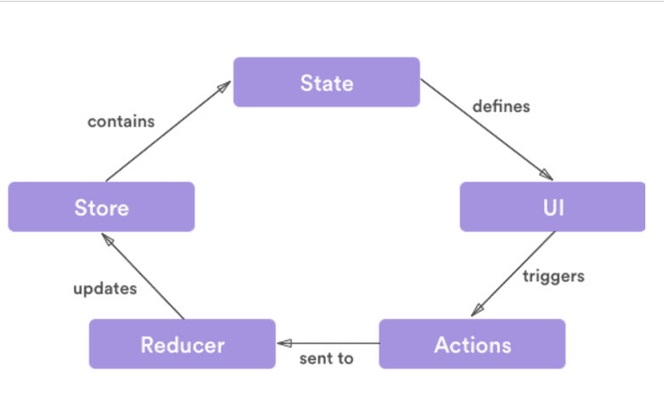
Redux

Slide 6

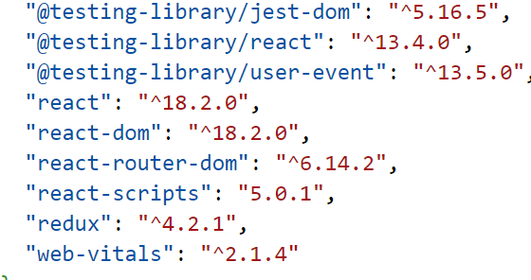
Redux
React component subscribes to the store and get the latest state during initialization of the application.
To change the state, React component creates necessary action and dispatches the action.
Reducer creates a new state based on the action and returns it. Store updates itself with the new state.
Once the state changes, store sends the updated state to all its subscribed component.
Install redux
npm install redux
After installation check package.json file

Slide 7
REDUX store using the official create store function
Store.js
import {createStore} from 'redux';
const initialState={
balance:0,
fullName:"",
mobile:8985652930
}
function acctReducer(state=initialState,action)
{
if(action.type==="deposit")
return {...state,balance:state.balance+action.payload};
else if(action.type==="withdraw")
return {...state,balance:state.balance-action.payload};

Slide 8
REDUX store using the official create store function
else if(action.type==="mobileUpdate")
return {...state,mobile:action.payload}
else if(action.type==="nameUpdate")
return {...state,fullName:action.payload}
else
return state
}
const store=createStore(acctReducer);
console.log(store.getState())
store.dispatch({type:"deposit",payload:1000})
console.log(store.getState())

Slide 9
REDUX store using the official create store function
store.dispatch({type:"withdraw",payload:200})
console.log(store.getState())
store.dispatch({type:"nameUpdate",payload:"rama"})
console.log(store.getState())
store.dispatch({type:"",payload:"rama"})
console.log(store.getState())

Slide 10
REDUX store using the official create store function
App.js
import './Store'
function App()
{
return(
<h1>
redux example
</h1>
)
}
export default App

Slide 11
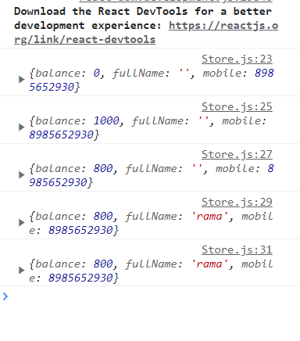
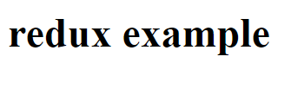
REDUX store using the official create store function
Index.js
import React from 'react';
import ReactDOM from 'react-dom/client';
import App from './App'
let root=ReactDOM.createRoot(document.getElementById('root'));
root.render(<App/>)

Slide 12
REDUX store using the official create store function
Store.js
import {createStore} from 'redux';
const initialState={
balance:0,
fullName:"",
mobile:8985652930
}
function acctReducer(state=initialState,action)
{
switch(action.type)
{
case "deposit":
return {...state,balance:state.balance+action.payload};
case "withdraw":

Slide 13
REDUX store using the official create store function
return {...state,balance:state.balance-action.payload};
case "mobileUpdate":
return {...state,mobile:action.payload};
case "nameUpdate":
return {...state,fullName:action.payload};
default:
return state
}
}
const store=createStore(acctReducer);
console.log(store.getState())
store.dispatch({type:"deposit",payload:1000})
console.log(store.getState())

Slide 14
REDUX store using the official create store function
store.dispatch({type:"withdraw",payload:200})
console.log(store.getState())
store.dispatch({type:"nameUpdate",payload:"rama"})
console.log(store.getState())
store.dispatch({type:"",payload:"rama"})
console.log(store.getState())

Slide 15
REDUX store using the official create store function
App.js
import './Store'
function App()
{
return(
<h1>
redux example
</h1>
)
}
export default App

Slide 16
REDUX store using the official create store function
Index.js
import React from 'react';
import ReactDOM from 'react-dom/client';
import App from './App'
let root=ReactDOM.createRoot(document.getElementById('root'));
root.render(<App/>)

Slide 17
Global state management using redux
Npm install react-redux
First we have a provider component that receives store as props. This is what grants access to our store from all the components wrapped in it.
Then we have a hook called useDispatch() (that we'll use to dispatch actions) and another called useSelector() (that we'll use to read the state from the store).
Last, notice we're dispatching the functions we declared on the actions file, and passing a value as an input when it corresponds. This value is what the actions takes as payload and what the reducer is going to use to modify the state. ;)

Slide 18
Global state management using redux
Account.js
import { useSelector } from "react-redux"
function Account(){
let data= useSelector(
(state)=>{
return state;
}
);
return(<>
<div className="container">
<h2>hello Account</h2>
<table className="table table-bordered w-50">
<thead>

Slide 19
Global state management using redux
<tr> <th>balance</th>
<th>username</th>
<th>mobile</th>
</tr>
</thead>
<tbody>
<tr>
<td>{data.balance}</td>
<td>{data.fullname}</td>
<td>{data.mobile}</td>
</tr>
</tbody>
</table>
</div>
</>)
}
export default Account

Slide 20
Global state management using redux
Form.js
import { useState } from "react"
import { useDispatch } from "react-redux"
function Form()
{
let dispatch=useDispatch();
const [amount,setAmount]=useState("")
return(
<>
<div className="container">
<h2>Form</h2>
<div className="row">
<div className="col-4">
<input className="form-control" type="number" placeholder="enter amount"
value={amount}
onChange={(e)=>{

Slide 21
Global state management using redux
let data=e.target.value;
setAmount(data);
}}/>
</div>
<button className="btn btn-primary col-3"
onClick={()=>{dispatch({type:"deposit",payload:amount})
setAmount("")}}>Deposit</button>
<button className="btn btn-danger col-3"
onClick={()=>{dispatch({type:"withdraw",payload:amount})
setAmount("")}}>withdraw</button>
</div>
</div>
</>
)
}
export default Form

Slide 22
Global state management using redux
Store.js
import {createStore} from 'redux';
const initialState={
balance:0,
fullName:"",
mobile:8985652930
}
function acctReducer(state=initialState,action)
{
switch(action.type)
{
case "deposit":
return {...state,balance:state.balance+ +action.payload};

Slide 23
Global state management using redux
case "withdraw":
return {...state,balance:state.balance- +action.payload};
case "mobileUpdate":
return {...state,mobile:action.payload};
case "nameUpdate":
return {...state,fullName:action.payload};
default:
return state
}
}
const store=createStore(acctReducer);
export default store;

Slide 24
Global state management using redux
App.js
import Form from './Form'
import Account from './Account'
function App()
{
return(
<>
<Form/>
<Account/>
</>
)
}
export default App;

Slide 25
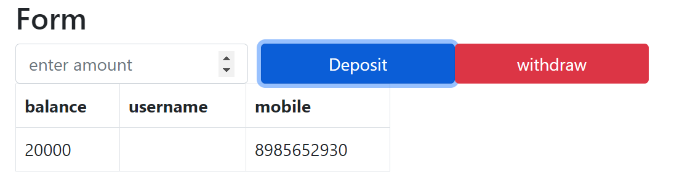
Global state management using redux
Index.js
import React from 'react';
import ReactDOM from 'react-dom/client';
import App from './App'
import {Provider} from 'react-redux'
import store from './store'
let root=ReactDOM.createRoot(document.getElementById('root'));
root.render(<Provider store={store}><App></App></Provider>)

Slide 26
Global state management using redux
Index.html
<!DOCTYPE html>
<html lang="en">
<head>
<meta charset="utf-8" />
<link rel="icon" href="%PUBLIC_URL%/favicon.ico" />
<link href="https://cdn.jsdelivr.net/npm/bootstrap@5.0.2/dist/css/bootstrap.min.css" rel="stylesheet" integrity="sha384-EVSTQN3/azprG1Anm3QDgpJLIm9Nao0Yz1ztcQTwFspd3yD65VohhpuuCOmLASjC" crossorigin="anonymous">
<script src="https://cdn.jsdelivr.net/npm/bootstrap@5.0.2/dist/js/bootstrap.bundle.min.js" integrity="sha384-MrcW6ZMFYlzcLA8Nl+NtUVF0sA7MsXsP1UyJoMp4YLEuNSfAP+JcXn/tWtIaxVXM" crossorigin="anonymous"></script>

Slide 27
Global state management using redux
<title>React App</title>
</head>
<body>
<div id="root"></div>
</body>
</html>

Slide 28
adding an API service as a middleware/loading state for that particular API
Redux supports middleware, and middleware functions run between dispatching an action and the moment it reaches the reducer.
Redux middlewares can be used for logging, routing, asynchronous actions, etc
we will focus on a redux middleware called thunk. It allows us to return functions instead of objects from redux actions.
Plain redux doesn’t allow complex logic inside action functions, you can only perform simple synchronous updates by dispatching actions.
This middleware extends its ability and lets you write complex logic that interacts with the store.
Thunk doesn’t interfere with the action until it returns a function. Thunk allows us to dispatch actions manually, which gives us the power to incorporate some logic or run some asynchronous code before dispatching an action.
.

Slide 29
adding an API service as a middleware/loading state for that particular API
The function returned from action is called a thunk function which is called with two arguments :
1. dispatch: It is a method used to dispatch actions, that can be received by reducers. 2. getState: It gives access to store inside the thunk function.
A thunk function may contain any arbitrary logic, sync, or async, and can call dispatch or getState at any time
.

Slide 30
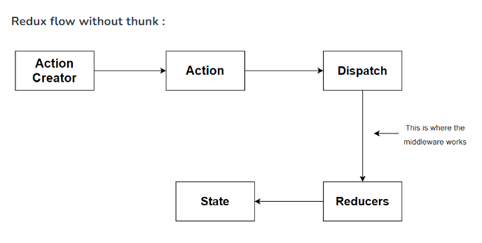
adding an API service as a middleware/loading state for that particular API

Slide 31

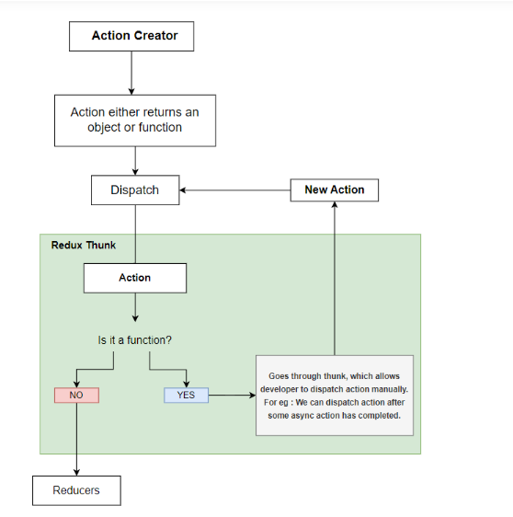
adding an API service as a middleware/loading state for that particular API

Slide 32

adding an API service as a middleware/loading state for that particular API
Setup of Redux with Thunk:
Step 1: To set up redux with thunk, we will start by creating a react application, and install all the required dependencies. Run the following command to create a new react application.
npm -g create-react-app
Create-react-app appname
Step 2: Open your project in a code editor and install all the required packages: redux, react-redux & redux-thunk.

Slide 33
adding an API service as a middleware/loading state for that particular API
Store.js
import {applyMiddleware,createStore} from 'redux'
import thunk from 'redux-thunk'
const initialstate={
userData:{
},
}
function userReducer(state=initialstate,action){
switch(action.type)
{
case 'add':
return{...state,userData:action.payload};
default:
return state
}
}

Slide 34
adding an API service as a middleware/loading state for that particular API
const store=createStore(userReducer,applyMiddleware(thunk))
export default store

Slide 35
adding an API service as a middleware/loading state for that particular API
App.js
import {useDispatch} from 'react-redux';
import {useSelector} from 'react-redux';
function App(){
const dispatch=useDispatch();
let data=useSelector((state)=>state)
console.log(data)
async function fetchData(dispatch,getState){
let res=await fetch('https://jsonplaceholder.typicode.com/users/2')
let data= await res.json()
dispatch({type:'add',payload:data})
}

Slide 36
adding an API service as a middleware/loading state for that particular API
return(
<>
<button className="btn btn-primary" onClick={()=>dispatch(fetchData)}>get</button>
</>
)
}
export default App;

Slide 37
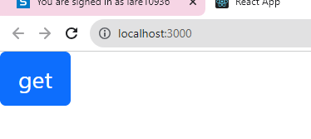
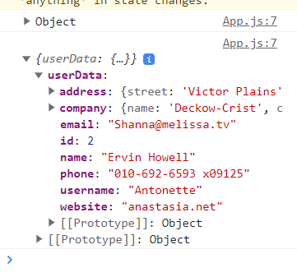
adding an API service as a middleware/loading state for that particular API
Index.js
import React from 'react';
import ReactDOM from 'react-dom/client';
import App from './App'
import {Provider} from 'react-redux'
import store from './store'
let root=ReactDOM.createRoot(document.getElementById('root'));
root.render(<Provider store={store}><App></App></Provider>)

Slide 38
adding an API service as a middleware/loading state for that particular API
Index.html
<!DOCTYPE html>
<html lang="en">
<head>
<meta charset="utf-8" />
<link rel="icon" href="%PUBLIC_URL%/favicon.ico" />
<link href="https://cdn.jsdelivr.net/npm/bootstrap@5.0.2/dist/css/bootstrap.min.css" rel="stylesheet" integrity="sha384-EVSTQN3/azprG1Anm3QDgpJLIm9Nao0Yz1ztcQTwFspd3yD65VohhpuuCOmLASjC" crossorigin="anonymous">
<script src="https://cdn.jsdelivr.net/npm/bootstrap@5.0.2/dist/js/bootstrap.bundle.min.js" integrity="sha384-MrcW6ZMFYlzcLA8Nl+NtUVF0sA7MsXsP1UyJoMp4YLEuNSfAP+JcXn/tWtIaxVXM" crossorigin="anonymous"></script>

Slide 39
REDUX toolkit has a configure store API
Writing Redux code can become complex and verbose, particularly as the size of an application grows. As the number of reducers and actions increase, it can become challenging to manage the different pieces and keep track of everything.
Fortunately, Redux Toolkit provides a solution to this problem. It gives a more streamlined and efficient way to manage the state of your application by abstracting away some of the more complex and repetitive aspects of Redux, such as creating reducers and actions.

Slide 40

REDUX toolkit has a configure store API
How to set up Redux Toolkit
To use Redux Toolkit in your React application, you need to install two dependencies: @reduxjs/toolkit and react-redux.
The @reduxjs/toolkit package provides the necessary tools to simplify Redux development, while react-redux is needed to connect your Redux store to your React components.

Slide 41
REDUX toolkit has a configure store API
How to create a slice
Once you have installed the needed dependencies, create a new "slice" using the createSlice function. A slice is a portion of the Redux store that is responsible for managing a specific piece of state.
To create a slice to manage our ToDo application, create a new file named src/features/todo/todoSlice.js and add the following code.

Slide 42
REDUX toolkit has a configure store API
todoSlice.js
import { createSlice } from "@reduxjs/toolkit";
const initialState = {
tasks: [ ],
};
const todoSlice = createSlice({
name: "todo",
initialState,
reducers: {
addTodo: (state, action) => {
state.tasks.push({ id: Date.now(), text: action.payload });
},
deleteTodo: (state, action) => {
state.tasks = state.tasks.filter((task) => task.id !== action.payload);
},
},
});

Slide 43
REDUX toolkit has a configure store API
export const { addTodo, deleteTodo } = todoSlice.actions;
export default todoSlice.reducer;
The above code defines a slice named todoSlice, with an initialState object that contains an empty array of tasks.
The reducers object defines two reducer functions: addTask and deleteTask. addTask pushes a new task object into the tasks array, and deleteTask removes a task from the tasks array based on its id property.
The createSlice function automatically generates action creators and action types based on the names of the reducer functions you provide. So you don't have to define the action creators yourself manually.

Slide 44
REDUX toolkit has a configure store API
The export statement exports the generated action creators, which can be used in other parts of your app to dispatch actions to the slice.
And finally, the todoSlice.reducer function handles all actions automatically generated based on the reducer objects provided to the createSlice function. By exporting it as the default, you can combine it with other reducers in your application to create a complete Redux store.

Slide 45
REDUX toolkit has a configure store API
How to set up Redux Store
Creating a Redux store is much simpler with Redux Toolkit.
To create a store for the application, add a file named src/store.js and add the following code:
Store.js
import { configureStore } from "@reduxjs/toolkit";
import todoReducer from "./features/todo/todoSlice";
const store = configureStore({
reducer: {
todo: todoReducer,
},
});
export default store;

Slide 46
REDUX toolkit has a configure store API
In this example, we first import the configureStore function from the @reduxjs/toolkit package, and the todoReducer function from a separate file.
Then, we create a store object by calling configureStore and passing it an object with a reducer property. The reducer property is an object that maps reducer slice names to their corresponding reducer functions. In this case, we have one reducer slice called todo, and its corresponding reducer function is todoReducer.
Finally, we export the store object so that it can be imported and used in other parts of the application.

Slide 47
REDUX toolkit has a configure store API
How to provide the Redux store to React
To make your Redux store available to the React components in your application, import the Provider component from the react-redux library and wrap your root component (usually <App>) with it.
The Provider component takes in the store as a prop and passes it down to all the child components that need access to it.

Slide 48
REDUX toolkit has a configure store API
Index.js
import React from "react";
import ReactDOM from "react-dom/client";
import App from "./App.jsx";
import "./index.css";
import store from "./store.js";
import { Provider } from "react-redux";
ReactDOM.createRoot(document.getElementById("root")).render(
<React.StrictMode>
<Provider store={store}>
<App />
</Provider>
</React.StrictMode>
);

Slide 49
REDUX toolkit has a configure store API
Create components
You can now create React components such as Task.jsx and TaskList.jsx that use the useSelector hook to access the current state from the store. Similarly, you can use the useDispatch hook to dispatch actions to update the store, just as you did in plain Redux.

